Slide 1



ABMSP'S
Anantrao Pawar College of Engineering & Research
A
Project Review (Stage II)
On
“YOLO-v8 Based AI System for In-Depth Tennis Match Analysis”
Presented By
VAIBHAV RATHOD Exam No: B401100126
DEEPAK RAJPUT Exam No: B401100152
SAGAR SARODE Exam No: B401100139
SIYA DEVHARKAR Exam No: B401100142
Under the Guidance of
Prof.Dewendra Bharambe
Department of Computer Engineering
Savitribai Phule University
A.Y. - 2024-25

Slide 2
Contents
Problem Statement
Purpose of Study
Aim and Objectives
Introduction
Literature Review
Methodology
Design and Modeling
Results and Discussions
Conclusions
APCOER, PUNE (A.Y. 2024-25)

Slide 3

Problem Statement
Lack of real-time performance metrics limits coaching effectiveness.
Existing systems are either expensive or lack in-depth player and shot analytics.
There is no affordable, AI-based solution for automated, real-time match analysis
APCOER, PUNE (A.Y. 2024-25)

Slide 4
Aim and Objectives
Aim:
“To develop an AI-powered system using YOLO-v8 for in-depth analysis of tennis matches by accurately tracking player and ball movement, calculating speed metrics, and generating actionable performance insights. ”
Objectives:
Enhance Coaching Efficiency
Improve Player Performance
Support Injury Prevention
Democratize Professional Analysis
Create Historical Performance Archives
Cost Effective
APCOER, PUNE (A.Y. 2024-25)

Slide 5
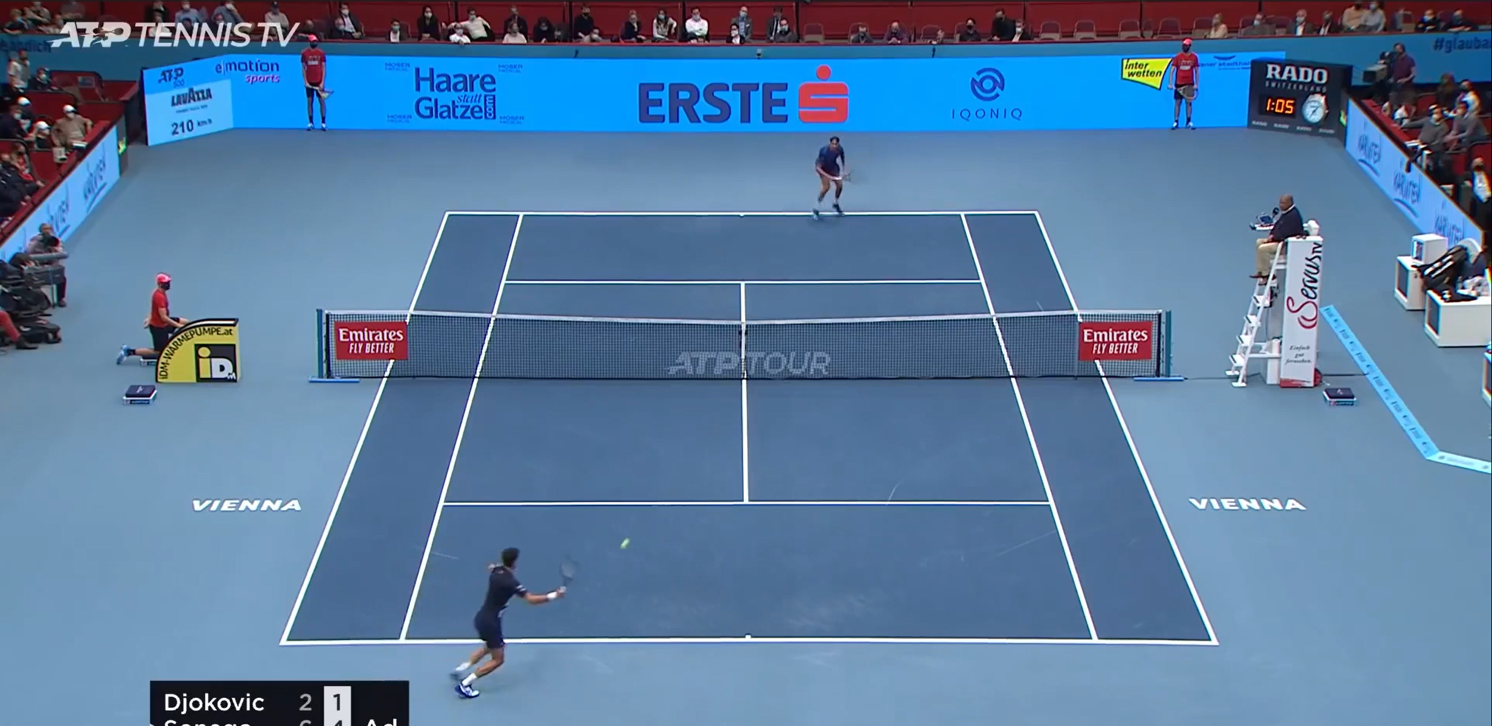
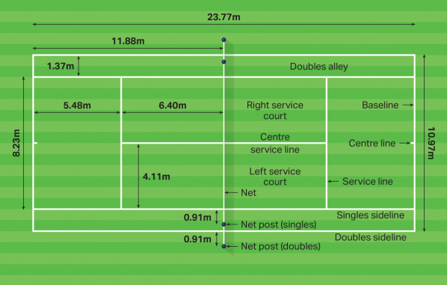
Introduction
How This Project Helps in the Real World –
Utilizes YOLO-v8: a high-performance yet lightweight AI model
Offers a cost-effective solution using standard video feeds
Delivers high accuracy in object detection and speed calculations
Reduces the need for human supervision or costly hardware
Makes advanced analytics accessible to smaller clubs
•Object detection
•Pose estimation
•Multi-object tracking
•Performance metrics
Traditional Methods -
Requires expensive equipment and expert analysts
Often lacks real-time feedback and consistent accuracy
Not scalable for grassroots, academies, or individual players
APCOER, PUNE (A.Y. 2024-25)

Slide 6
Literature Survey
Sr. No. | Title of Research Paper | Authors | Conference | Year of Publication | Findings
1 | Athlete Performance Analysis: Machine LearningforPredicting TennisPlayerScores | P. Zhao, T. Luo, andP.Bi | 6th International Conference on Communications, Information System and Computer Engineering (CISCE) | 2024 | Predicting tennis player per formance and scores.
2 | Momentum Prediction for Tennis Matches Based on Counter-Factual Analysis and Multi-LGBM | J. Guo, J. Zhu, S. Lin and F. Shi | 7th International Conference on Advanced Algorithms and Control Engineering (ICAACE) | 2024 | Predicting mo mentumshifts in tennismatches..
APCOER, PUNE (A.Y. 2024-25)

Slide 7
Literature Survey
Sr. No. | Title of Research Paper | Authors | Conference | Year of Publication | Findings
3 | A Visualization Approach for Player Action Evaluation in Soccer | A. Cao, X. Xie, M. Zhou, H. Zhang, M. Xu and Y. Wu | IEEE Transactions on Visualization and Computer Graphics | 2024 | Assessing and quantifying player action in soccer matches through visual ization
4 | Player Performance Prediction in Sports Using Machine Learning | R. M, R. B, L. R and S. K | International Conference on Intelligent Systems for Cybersecurity(ISCS) | 2024 | Predicting player performance across different sports.
APCOER, PUNE (A.Y. 2024-25)

Slide 8
Literature Survey
t | Title of Research Paper | Authors | Conference | Year of Publication | Findings
5 | A Monitoring System for Cattle Behavior Detection using YOLO-v8 in IoT Environments, | R. K. Jeong et al. | IEEE International Conference on Consumer Electronics (ICCE) | 2024 | Detectingandan alyzingcattlebe havior inIoTen vironments.
6 | Insight Analysis for Tennis Strategy and Tactics, | Z. Liu, K. Jiang, Z. Hou, Y. Lin and J. S. Dong | International Conference on Data Mining (ICDM) | 2023 | In-depth analysis of tennis strate giesandtactics.
APCOER, PUNE (A.Y. 2024-25)

Slide 9
Literature Survey
Sr. No. | Title of Research Paper | Authors | Conference | Year of Publication | Findings
7 | Footy Forecast– Measuring Performance in Football | C. Rohra, M. Mangla, S. Asher, N. Agarwal and S. Desai | International Conference on Advanced Computing Technologies and Applications (ICACTA) | 2023 | Performance analysis in football.
8 | The Design Method of Intelligent Sports Information Management System, | H. Yu, | International Conference on Evolutionary Algorithms and Soft Computing Techniques | 2023 | Design and de velopment of intelligent sports information management systems.
APCOER, PUNE (A.Y. 2024-25)

Slide 10
Literature Survey
Sr. No. | Title of Research Paper | Authors | Conference | Year of Publication | Findings
9 | A Method for Table Tennis Bat Trajectories Reconstruction with the Fusion of Human Keypoint Information, | Y. Zheng, W. Zhou, T. Zou and H. Zhang | IEEE International Conference on Network Intelligence and Digital Content | 2023 | Reconstructing table tennis bat trajectories.
10 | Deep Learning-Based Tennis Shot Type Prediction Using Gait Analysis | R. A et al. | Intelligent Computing and Control for Engineering and Business Systems | 2023 | Predicting tennis shottypes.
APCOER, PUNE (A.Y. 2024-25)

Slide 11
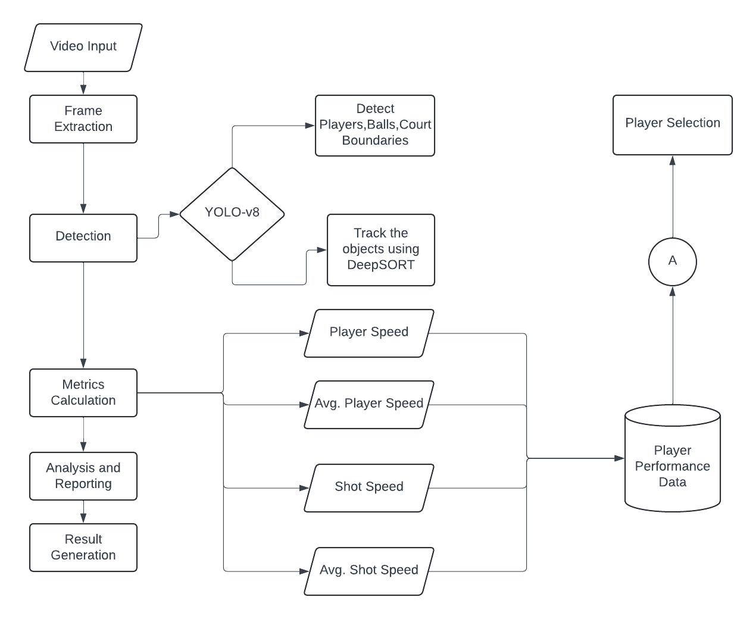
System Architecture of Proposed Work
APCOER, PUNE (A.Y. 2024-25)
APCOER, PUNE (A.Y. 2024-25)

Slide 12
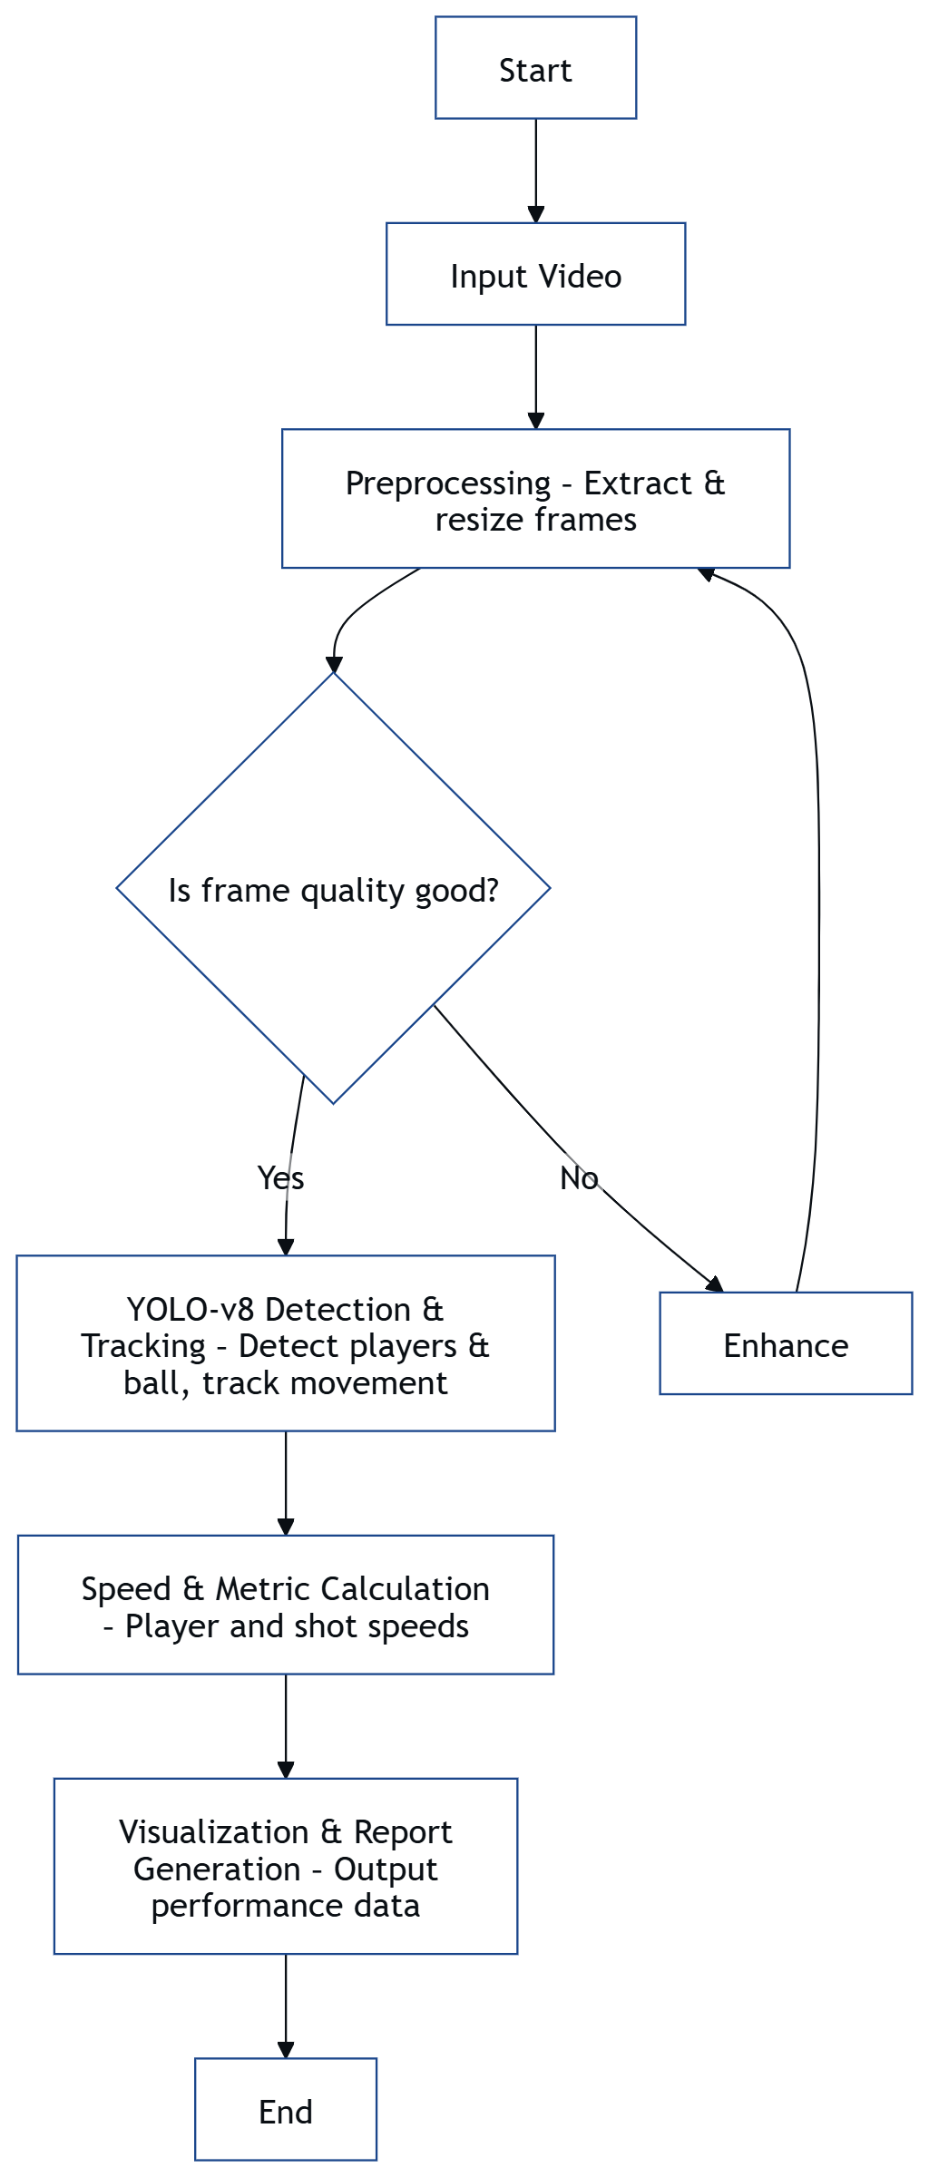
Methodology
APCOER, PUNE (A.Y. 2024-25)

Slide 13
DESIGN AND MODELLING
APCOER, PUNE (A.Y. 2024-25)

Slide 14
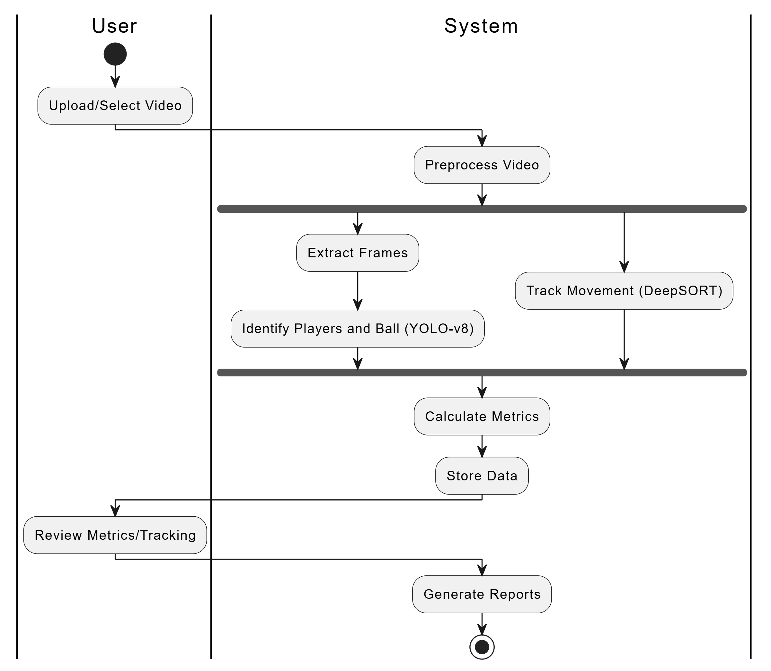
Activity Diagram of Proposed Work
APCOER, PUNE (A.Y. 2024-25)

Slide 15
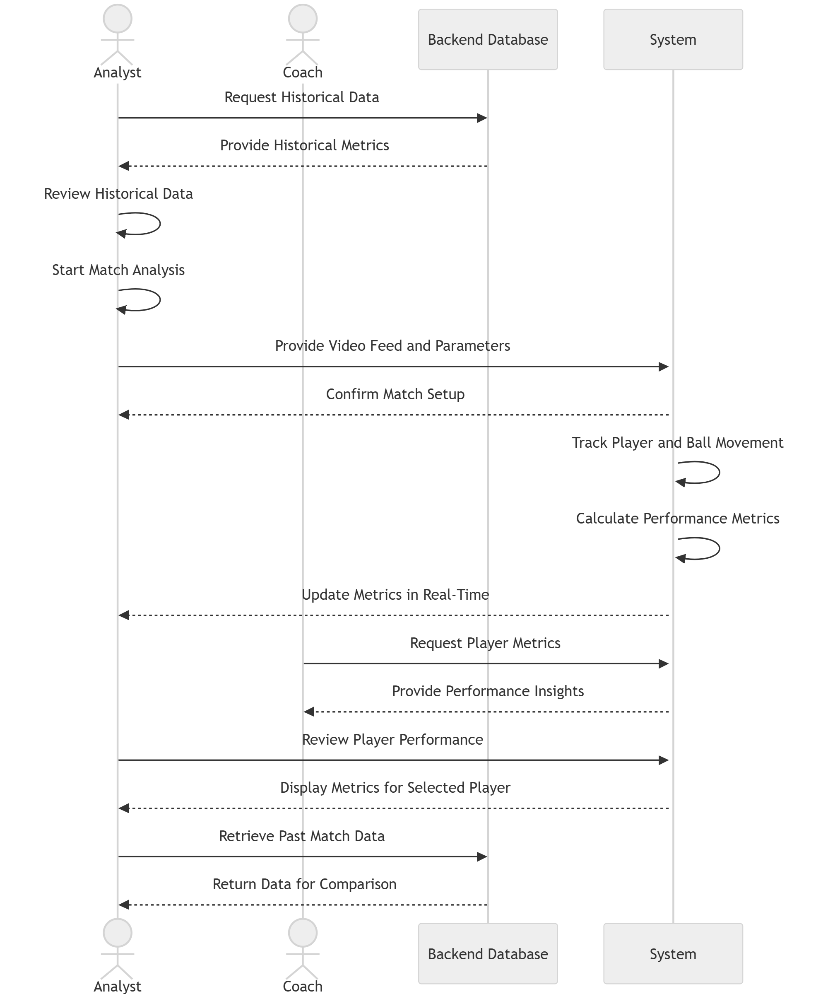
Use Case Diagram of Proposed Work
APCOER, PUNE (A.Y. 2024-25)

Slide 16
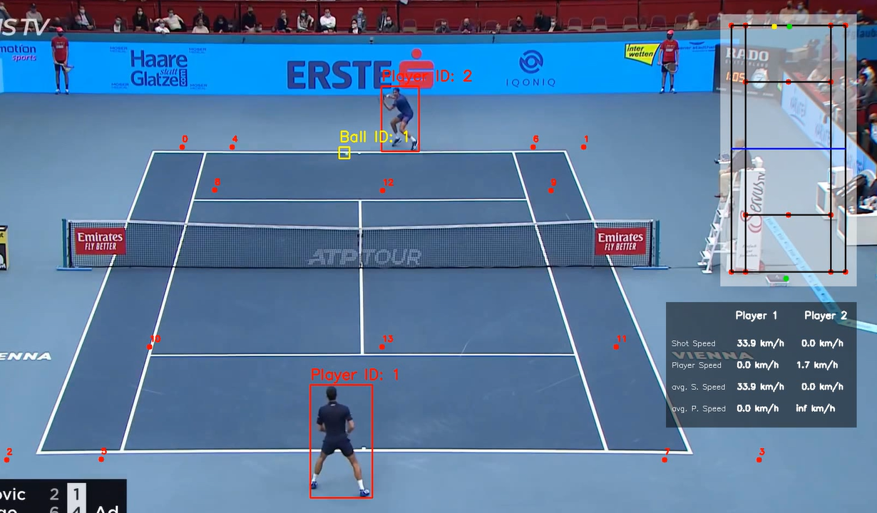
Result and Discussion
APCOER, PUNE (A.Y. 2024-25)

Slide 17
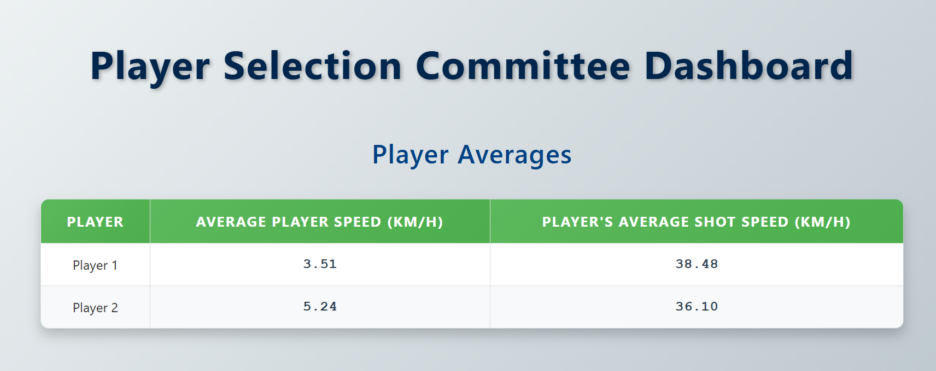
Comparison between players
APCOER, PUNE (A.Y. 2024-25)

Slide 18
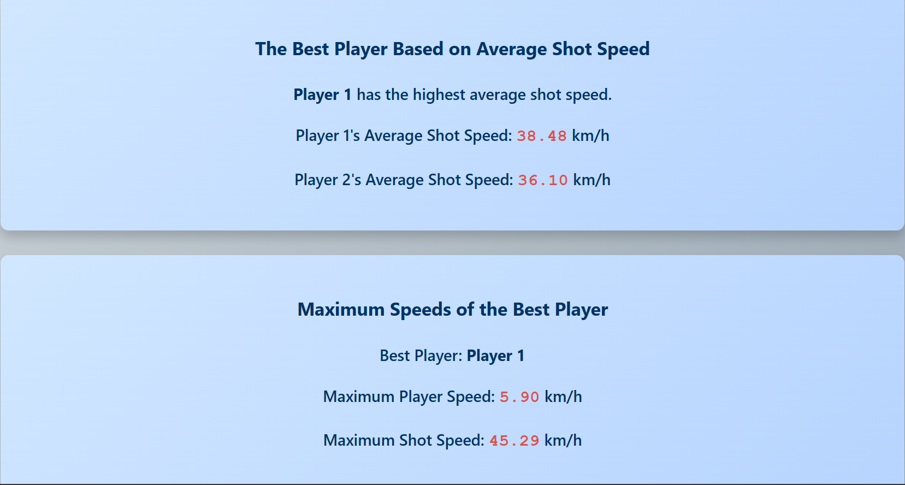
Best Player Selection
APCOER, PUNE (A.Y. 2024-25)

Slide 19
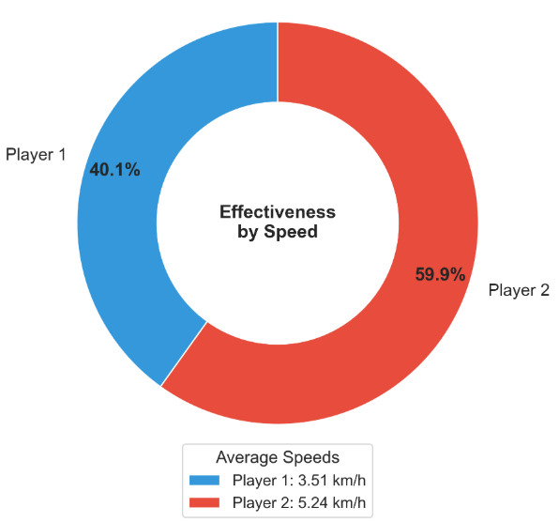
Effectiveness by Speed
APCOER, PUNE (A.Y. 2024-25)

Slide 20
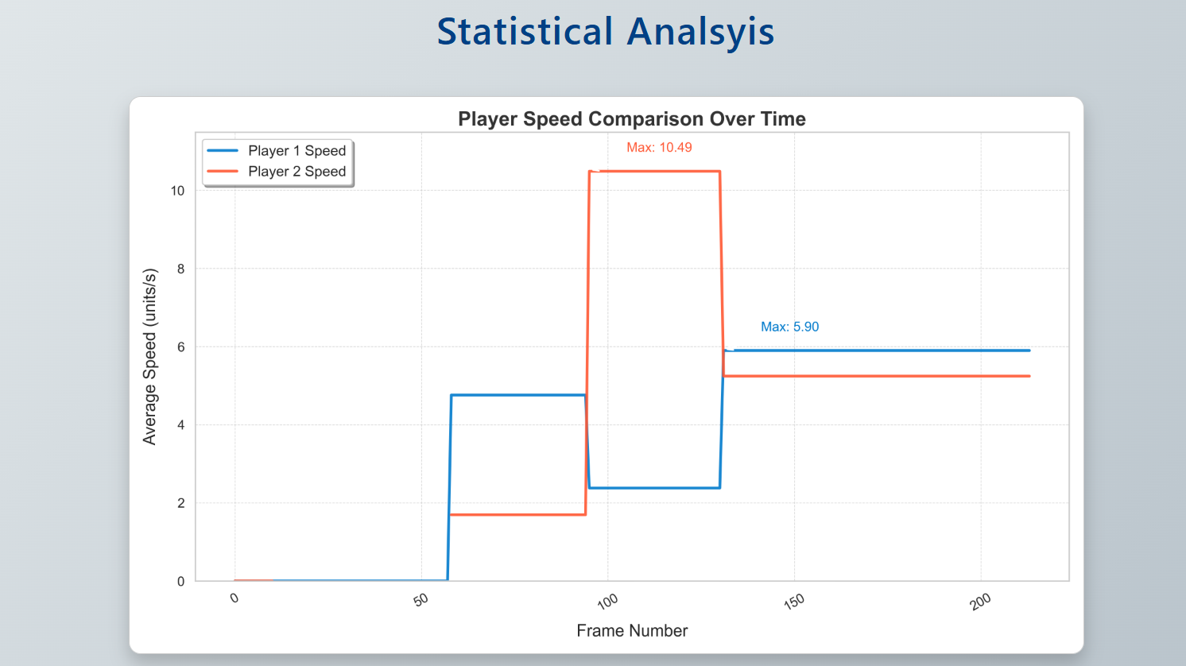
Statistical Analysis
APCOER, PUNE (A.Y. 2024-25)

Slide 21
Feedback for Players
APCOER, PUNE (A.Y. 2024-25)

Slide 22
Conclusions
The project successfully developed a YOLO-v8 based AI system for in-depth tennis match analysis, providing an automated solution to track players and the ball with high accuracy. By integrating YOLO-v8 with object tracking algorithms like DeepSORT, the system was able to calculate key performance metrics such as player speed, average player speed, shot speed, and average shot speed in real time. This significantly reduces the need for manual analysis and enables coaches, analysts, and players to gain valuable insights into match dynamics and performance patterns. The visual representation of these analytics through dashboards and reports adds further value to player evaluation and strategy formulation
APCOER, PUNE (A.Y. 2024-25)

Slide 23
Thank You
APCOER, PUNE (A.Y. 2024-25)

